Slide 1
Hashing, Hash Function and Hash Table

Slide 2
What is Hashing
Hashing is a technique that is used to uniquely identify a specific object from a group of similar objects.
Examples of how hashing is used in our lives:
In universities, each student is assigned a unique roll number that can be used to retrieve information about them.
In libraries, each book is assigned a unique number that can be used to determine information about the book
Hashing is the solution that can be used in almost all such situations and performs extremely well compared to above data structures like Array, Linked List, BST in practice

Slide 3
What is Hashing (Cond…)
With hashing we get O(1) search time on average and O(n) in worst case.
The idea is to use hash function that converts a given input number or any other key to a smaller number and uses the small number as index in a table called hash table.
Hash Function
Hash function maps a big number or string to a small integer that can be used as index in hash table
Hash Table
An array that stores pointers to records corresponding to a given input number

Slide 4
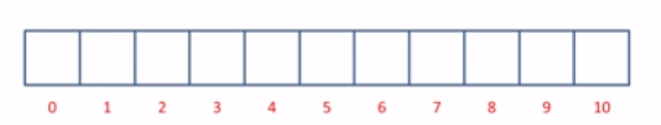

Slide 5
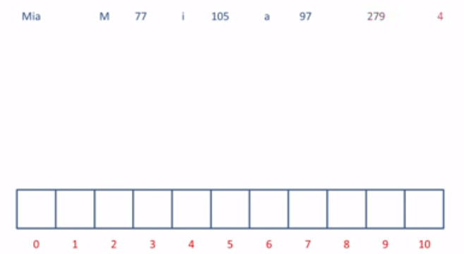

Slide 6
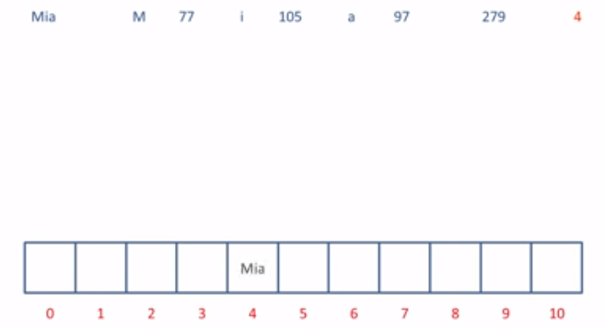

Slide 7
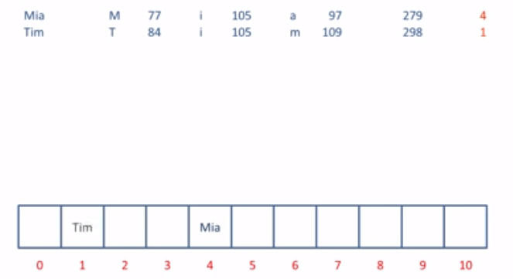

Slide 8
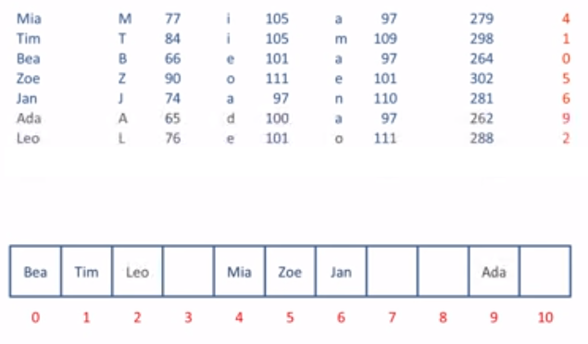

Slide 9
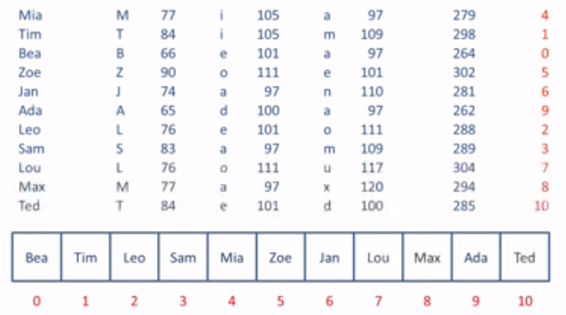

Slide 10
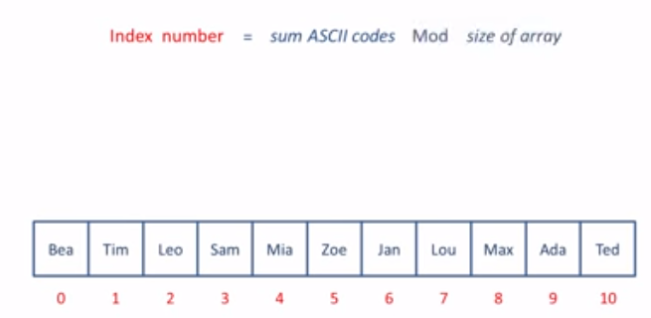

Slide 11
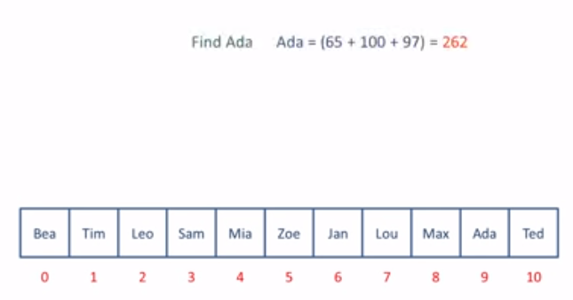




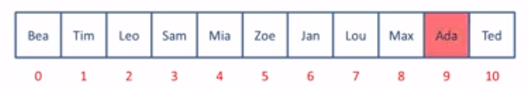

Slide 12
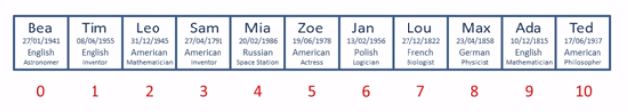

Slide 13
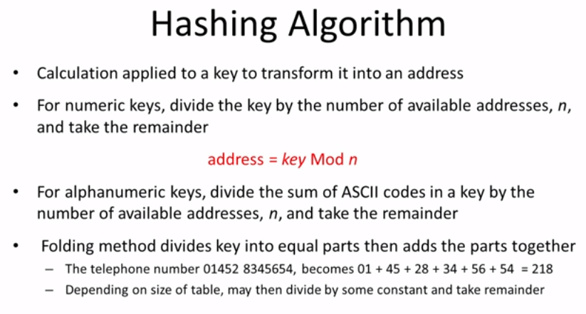

Slide 14
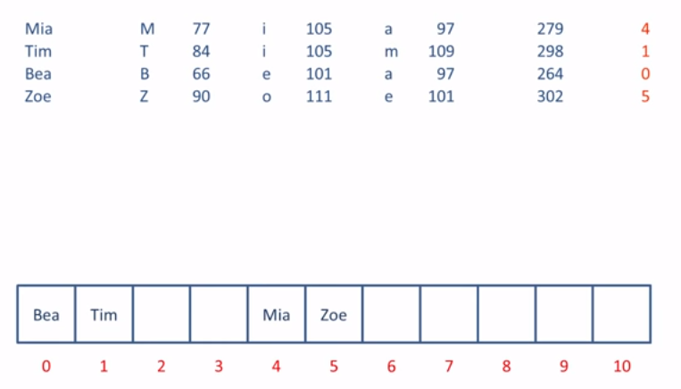
Understand Collision

Slide 15
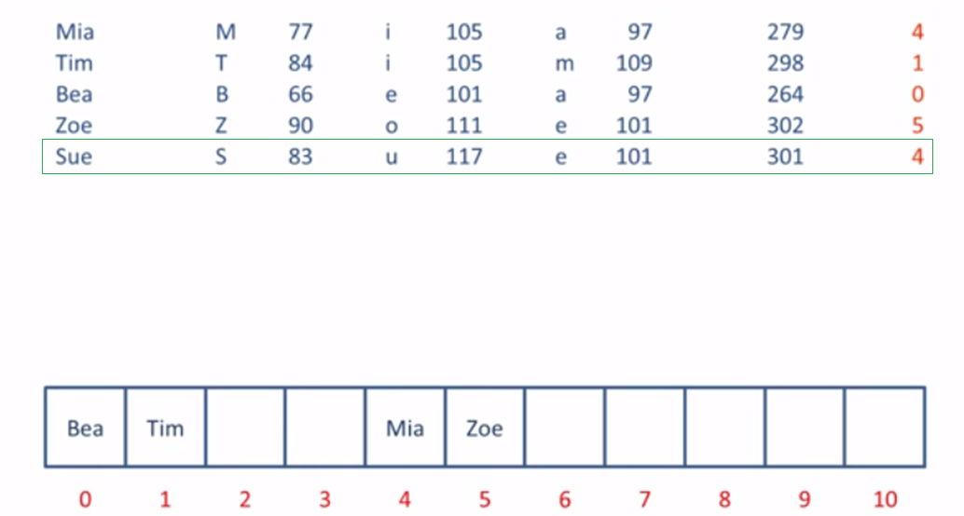
Understand Collision

Slide 16
Collision Handling
Irrespective of how good a hash function is, collisions are bound to occur.
Therefore, to maintain the performance of a hash table, it is important to manage collisions through various collision resolution techniques.
Open addressing
Linear Probing
Quadratic Probing
Double Hashing
Closed addressing

Slide 17
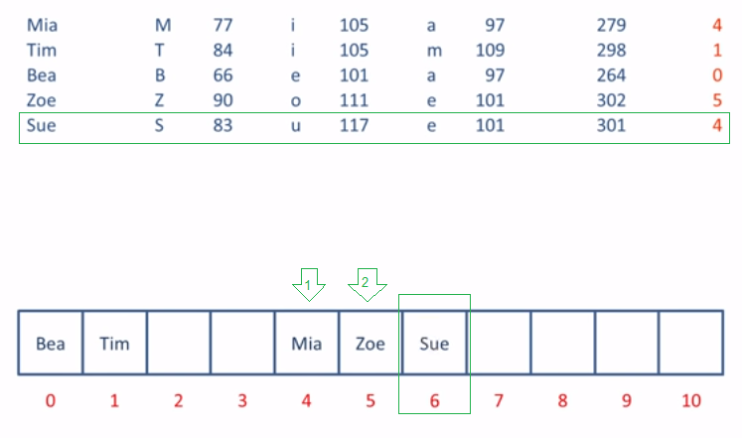
Open Addressing (Linear)

Slide 18
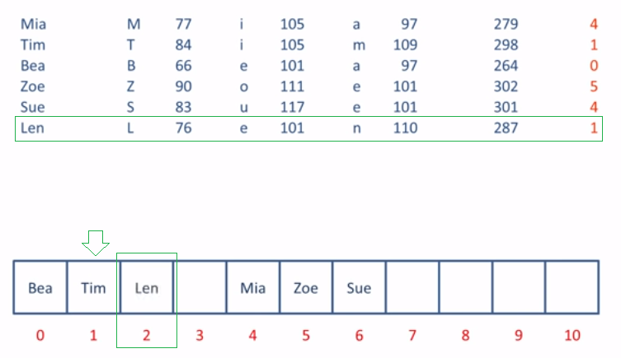

Slide 19
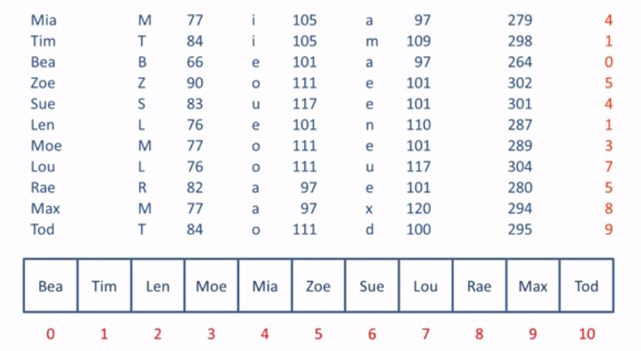

Slide 20
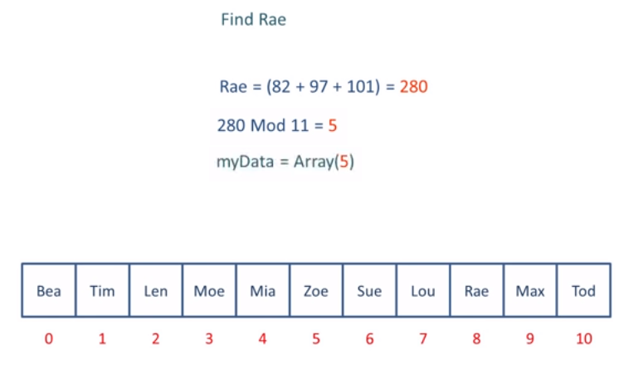

Slide 21
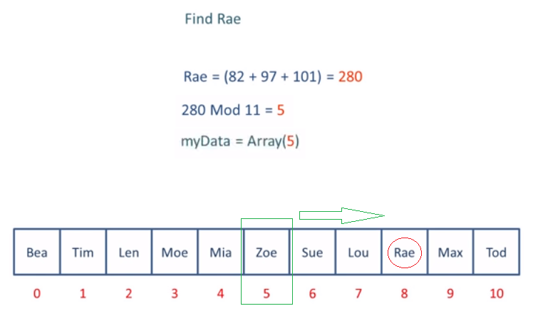

Slide 22
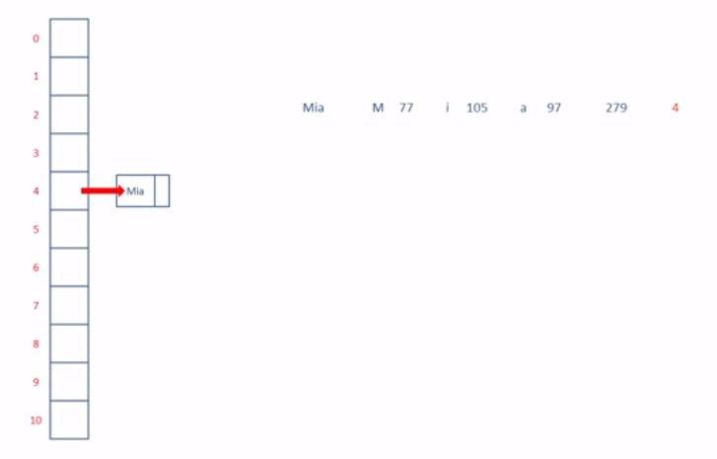
Closed Addressing (Non-Linear)

Slide 23
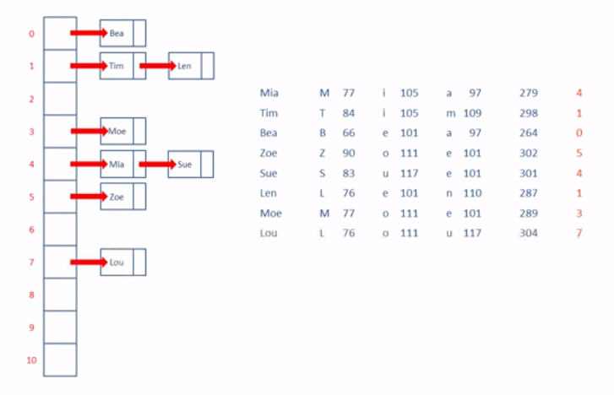

Slide 24
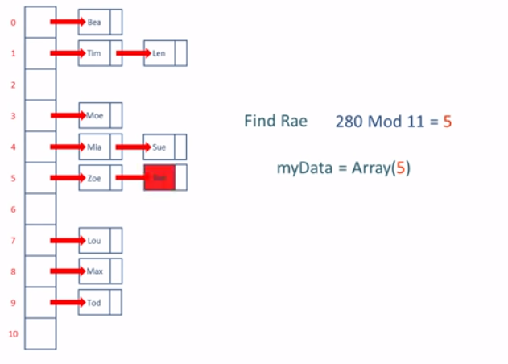

Slide 25
